Slide 1



Mobile Home Geeks

Slide 2
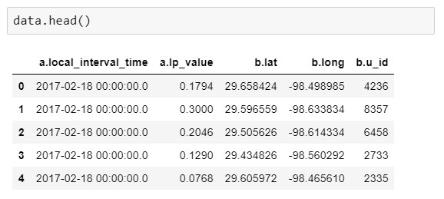
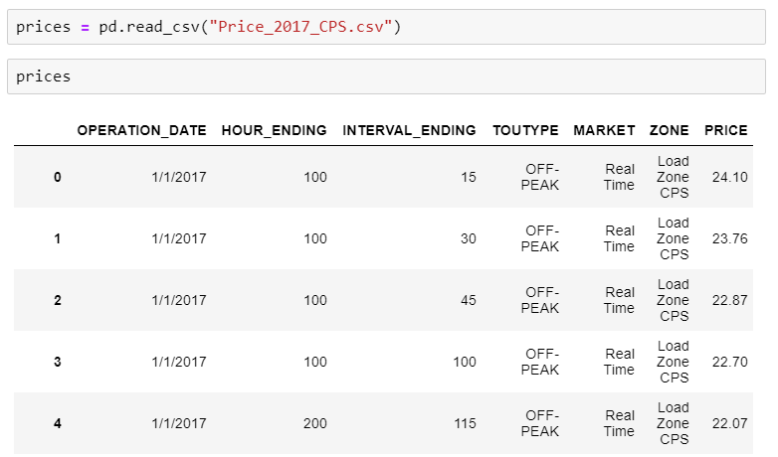
Action: Combined Consumption and Cost Data of 10k Homes in 15 Min Intervals
Result: CPS Bill per Month for 10k Homes

Slide 3
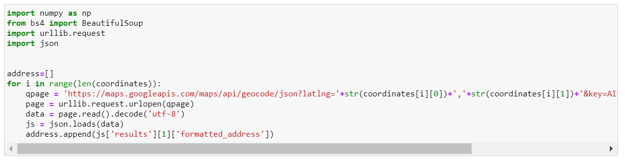

Action: Reverse Geocoding
Result: 9975 Physical Addresses

Slide 4
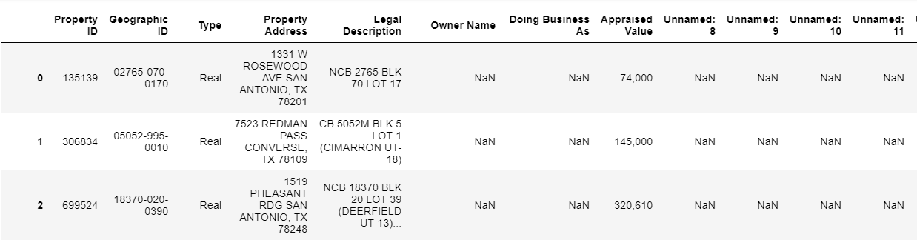
Action: Merged data from Bexar County Appraisal District Database
Result: Merged data from Bexar County Appraisal District Database

Slide 5
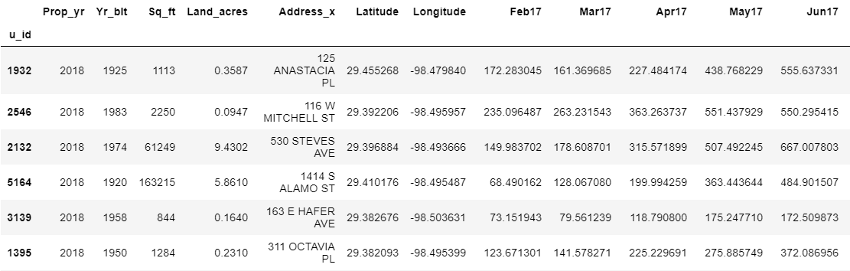
Final Data Set: CPS Bills Per Month + Home Address + Year Built + SqFt

Slide 6
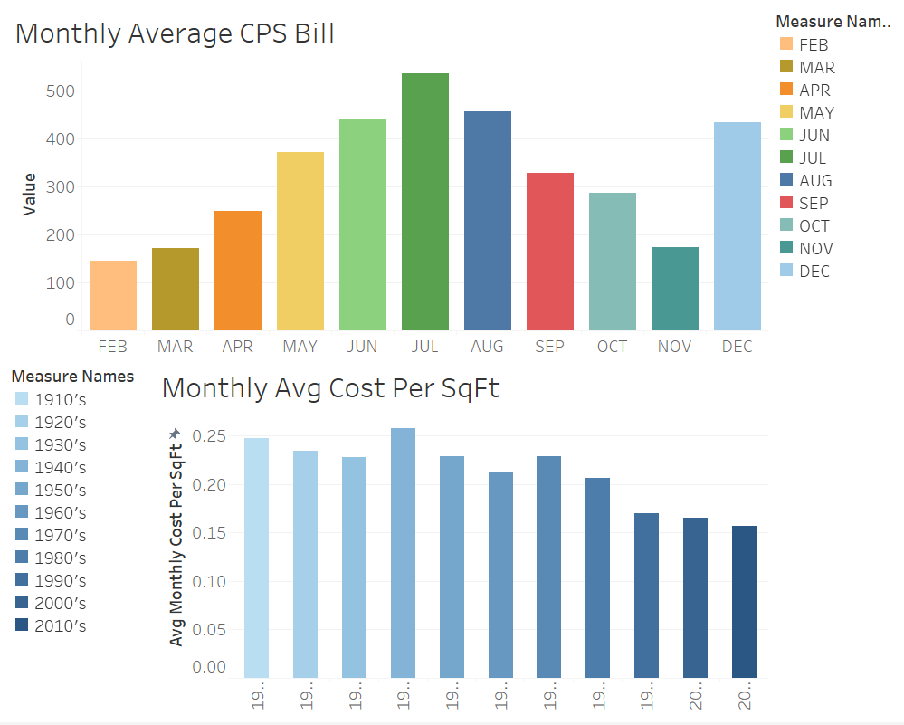

Slide 7
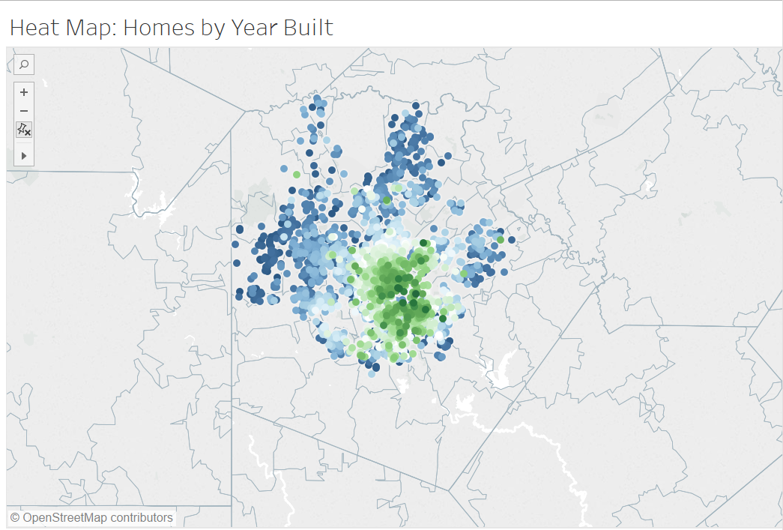

Slide 8
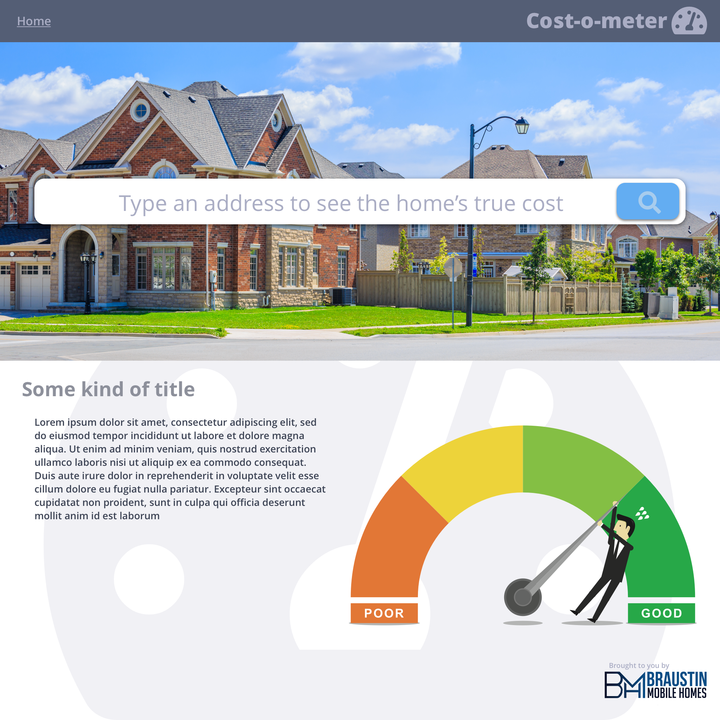

Slide 9
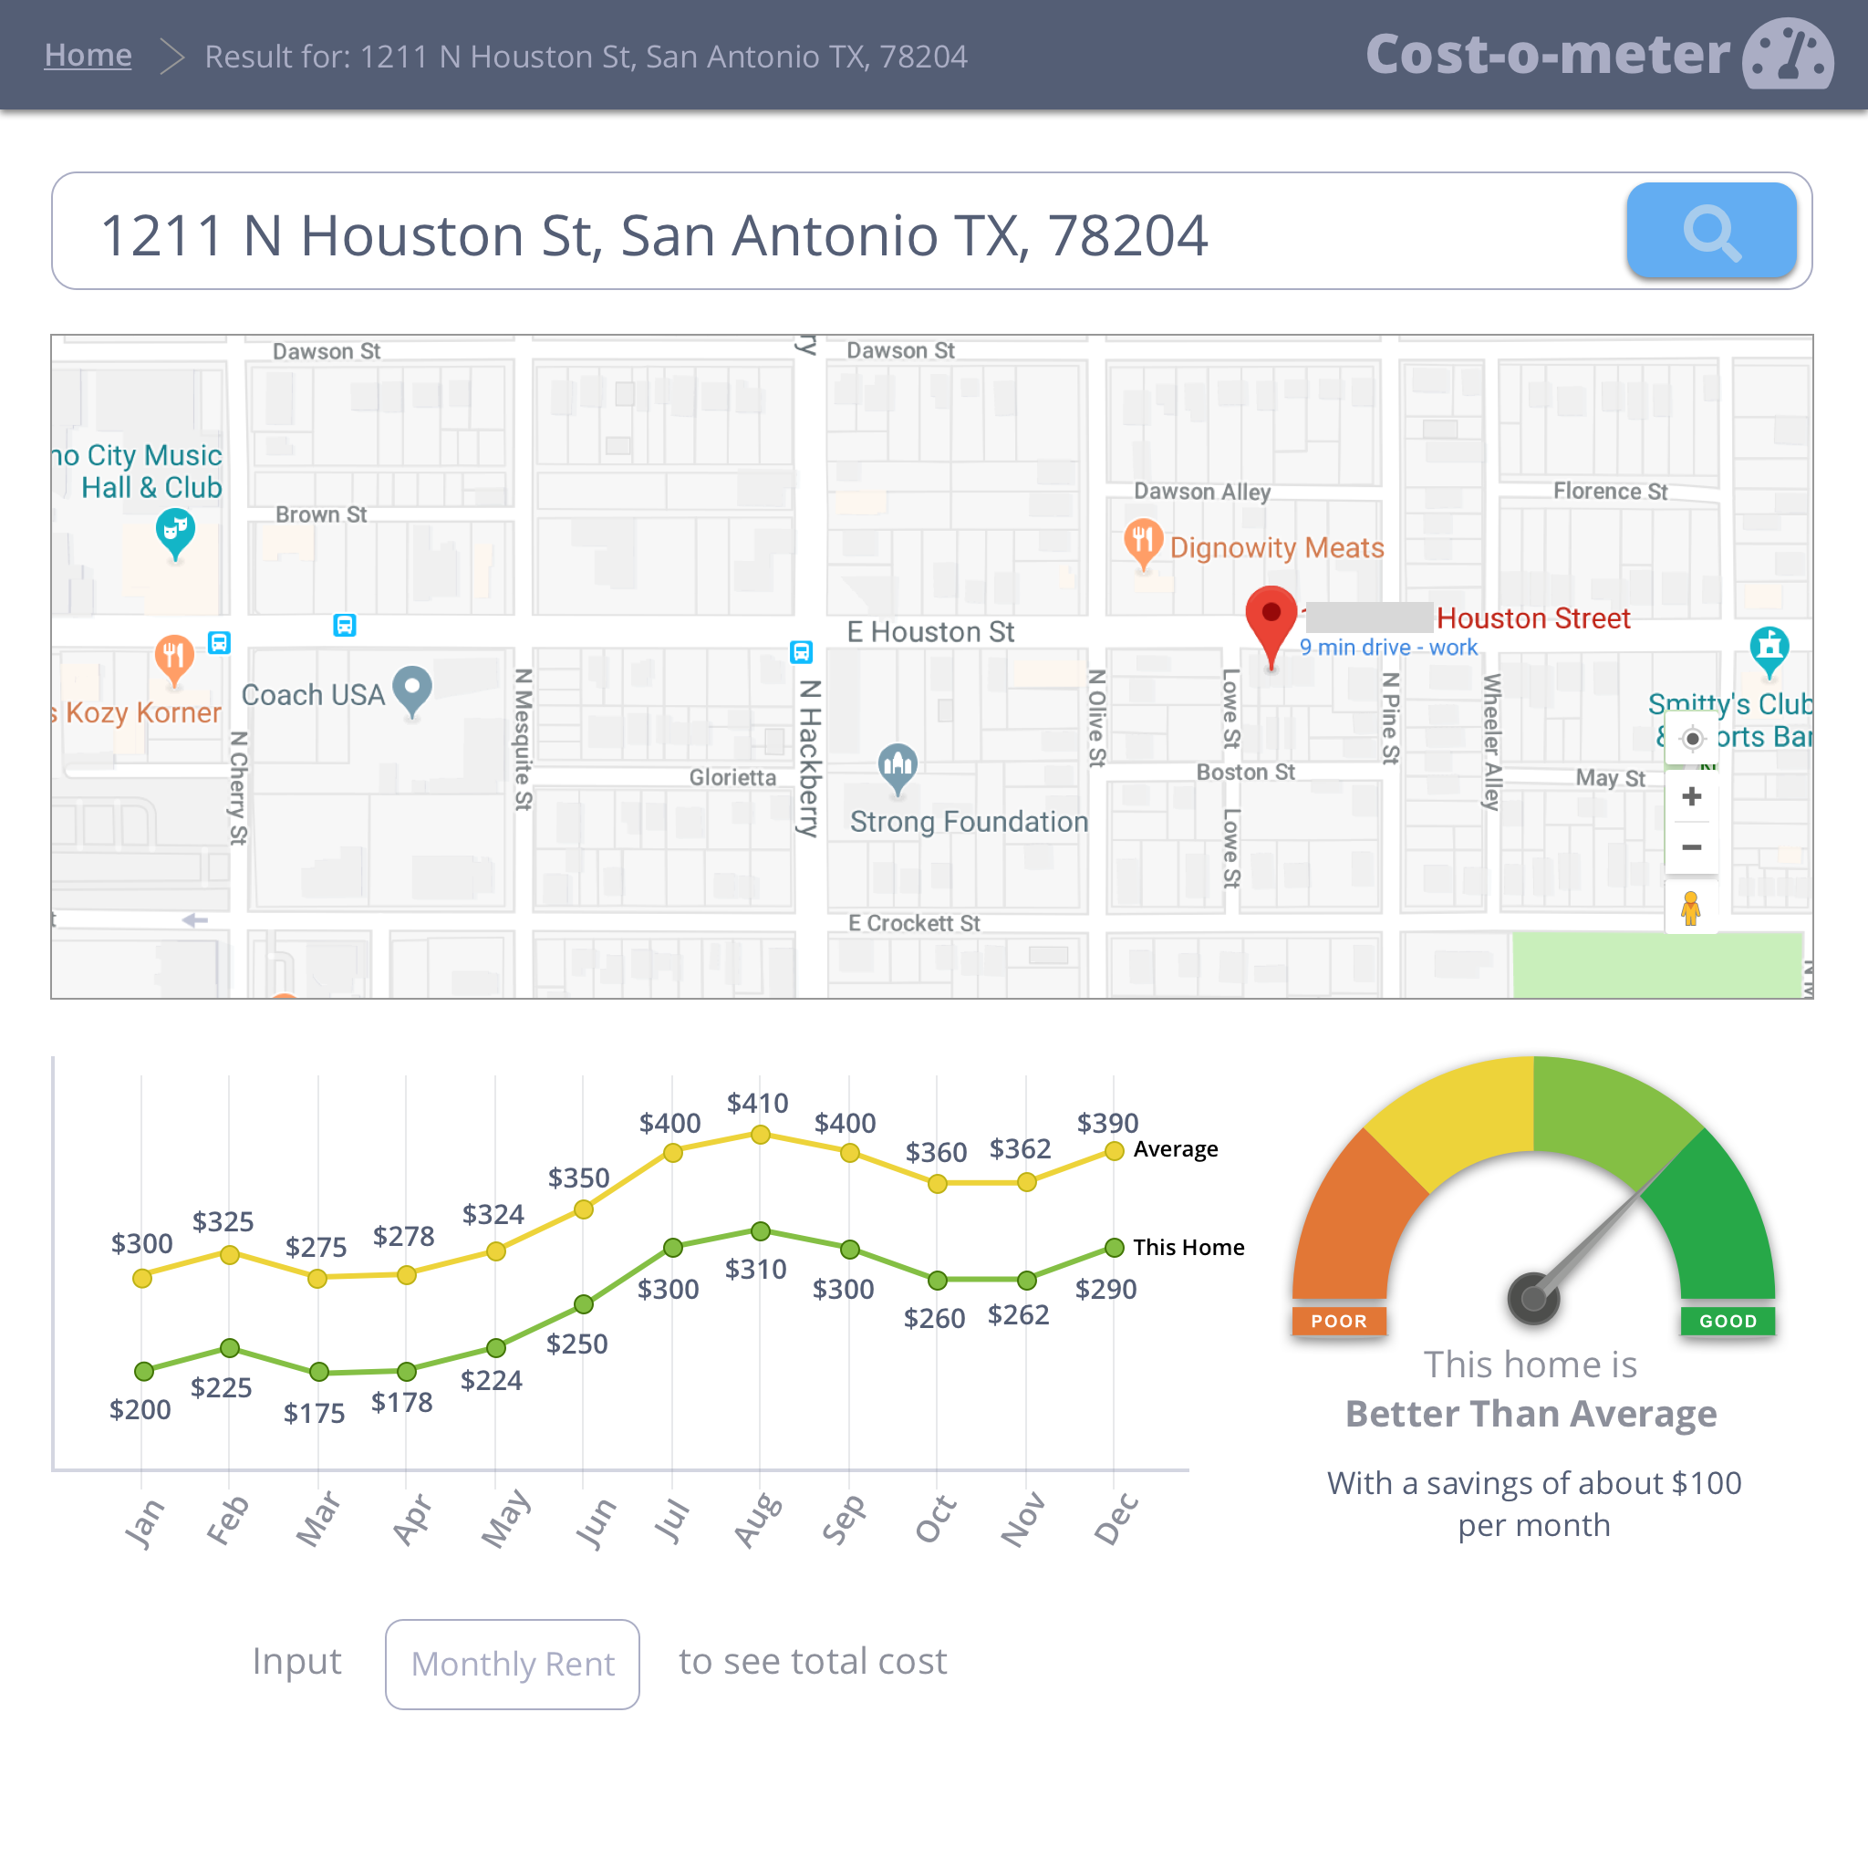

Slide 10
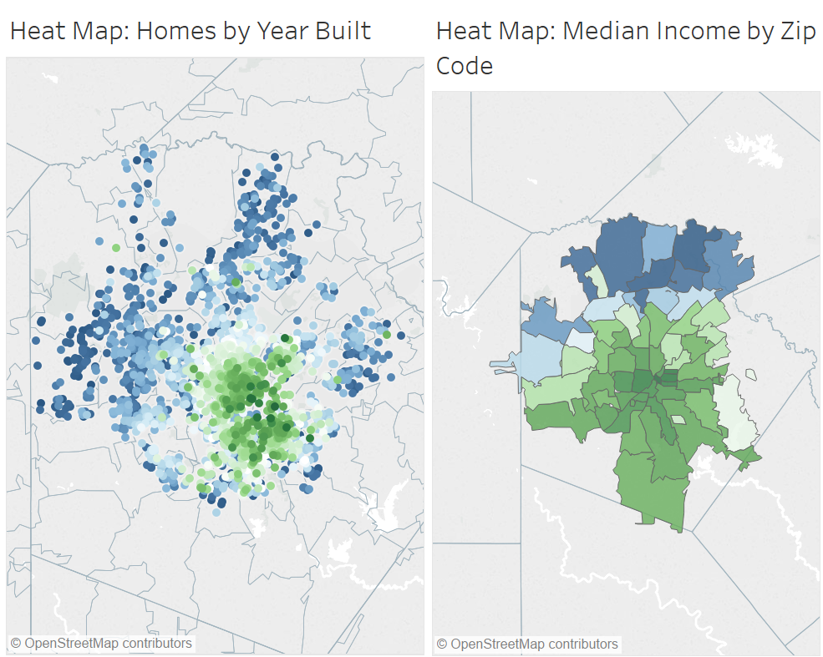

Slide 11
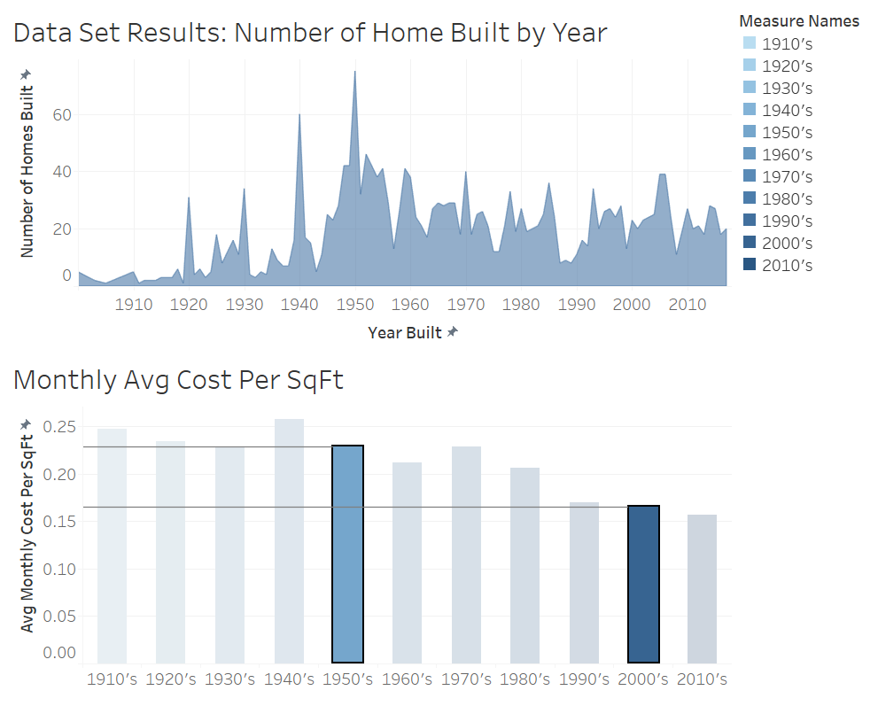
1,500 SqFt Home
$1,191 / Year Difference

Slide 12
Example of Proposed Solution
$6,000 Investment towards energy efficient upgrades in
the home.
Investment paid back through the energy savings while
maintaining residents bill at previous amount. (Potential $1,191)
After 5 years the initial investment would be paid back and
the resident would be able to reap the benefits of a reduced
CPS bill.

Slide 13
Benefits of Proposed Solution
Residents are able to reduce their burden on the power grid
without adding additional costs to their monthly budgets.
- Residents repay their loans by deferring the savings generated
from home improvements.
Tax payers are able to improve their city without a net cost
to them.
Energy waste is eliminated by creating efficiencies in our oldest
homes.

Slide 14
Questions?

